Slide 1
Ice Ages
Pleistocene 3 M.y.
Permian 250-220 M.y.
Ordovician 450 M.y.
Precambrian
900-650 M.y. (Snowball Earth)
2300 M.y.

Slide 2
Time (1000 Years) | North America | Alps | Northern Europe | Poland-Russia
0-18 | Interglacial
18-67 | Wisconsin | Wurm | Vistula | Varsovian
67-128 | Sangamon | Uznach | Eem | Masovian
128-180 | Illinoisan | Riss | Warthe/Saale | Cracovian
180-230 | Yarmouth | Hoetting | Holstein | Sandomirian
230-300 | Kansan | Mindel | Elster | Jaroslavian
300-330 | Aftonian |  | Cromer | Likhvin
330-470 | "Nebraskan " | Gunz |  | Menapian
470-540 |  |  | Waalian
540-550 |  | Donau II | Weybourne
550-585 |  |  | Tiglian
585-600 |  | Donau I
600-2000 | About 20 Glacial Advances
2000 (2 M.Y.) | Beginning of Pleistocene
4000 (4 M.Y.) | Dwarf forests still in Antarctica
15 M.Y. | First Glaciation in Antarctica

Slide 3
The Last 800,000 years

Slide 4
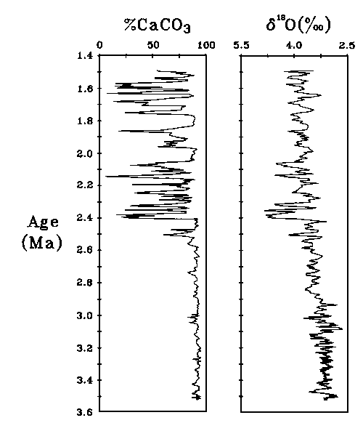
Beginning of the Ice Ages

Slide 5
Milankovich Cycles
Cool Summers More Important Than Cold Winters
Tilt of Axis
Shape of Orbit
Precession
Can’t be the whole story-have operated throughout earth history

Slide 6
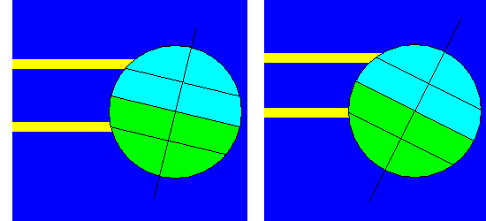
Axis Tilt
Small Axis Tilt: Mild winters but cool summers. Favors Ice Age
Large Axis Tilt: Cold winters but hot summers. Favors Interglacial

Slide 7
Axis Tilt and the Incredible Shrinking Tropics
Earth’s Axis Tilt is Shrinking
24.2 degrees 9,500 years ago
23.4 degrees now
22.6 degrees 10,200 years from now
Tropics are shrinking
14.7 m/year = 4 cm/day = 1.7 mm/hour
Temperate zones gain 1550 sq km/year
1080 at the expense of tropics
470 at the expense of Arctic and Antarctic

Slide 8
Precession: 26,000 year cycle

Slide 9
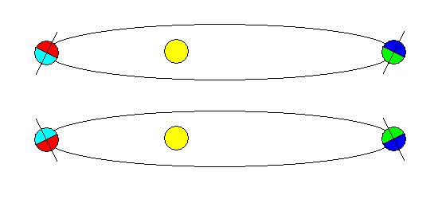
Shape of Orbit + Precession
Summer at Perihelion (Eccentric Orbit)
Cold winters but hot summers. Favors Interglacial
Summer at Aphelion (Eccentric Orbit)
Near-circular Orbit
Mild winters but cool summers. Favors Ice Age

Slide 10
The Greenhouse Effect
Without a natural Greenhouse Effect, earth would be frozen
90% due to Water Vapor
Other contributors: carbon dioxide, methane, nitrous oxides
“A little Greenhouse Effect is a good thing”
Carl Sagan
Problem: we are accelerating it with unknown final consequences

Slide 11
The Carbonate-Silicate Cycle
Earth has almost as much carbon dioxide as Venus
Volcanoes add carbon dioxide to the atmosphere
Carbon dioxide is removed from the air to make carbonate rocks
“Icehouse” and “Greenhouse” episodes

Slide 12
The Carbonate-Silicate Cycle
Mountain-building favors cooling
Uplift exposes rocks to weathering
Calcium silicates (plagioclase, amphiboles, pyroxenes) are chemically weathered
Calcium is carried to the sea where organisms bind it into carbonate minerals
Creation of carbonates removes carbon dioxide from the atmosphere
Weathering of carbonates returns carbon dioxide to the atmosphere

Slide 13
The Carbonate-Silicate Cycle
Plate tectonics carries some carbonates into the earth
Heat liberates carbon dioxide
Carbon dioxide returns to the atmosphere
The cycle does not require life but does require liquid water.

Slide 14
The Snowball Earth
Between 900 and 600 m.y. ago, Earth froze completely (or almost) about four times
Global freezing alternated with extremely rapid sea-level rise and global warming
Evidence:
Glacial deposits on all continents, even at low latitudes
Glacial deposits immediately succeeded by thick deposits of carbonate rocks

Slide 15
The Snowball Earth
Possible reasons:
Fainter early sun
Biological changes
Global ice cover
Weathering and erosion shut down
Volcanoes continue to erupt CO₂
At 10% CO₂, abrupt warming begins
Go from –50 C to +50 C in 10,000 years?
Implications for life?

Slide 16
What Causes Ice Ages?
Within Earth (Endogenic)
Carbonate-Silicate Cycle
Volcanic Eruptions - Sudden output of CO₂ (warming) or particulates (cooling)
Mountain Building - Changes in atmospheric circulation
Continent-Ocean configuration
Outside Earth (Exogenic)
Changes in Sun (faint early sun)
Variations in Earth Orbit (Milankovitch Cycles)
Don't Really Know

Slide 17
Are We Headed For Another Ice Age?
Heating & Cooling in Historic Times
Smoke, Haze, CO₂ May Alter Climate
Don't Really Know
Global warming due to fossil fuels may be catastrophic in many ways, but will probably not much affect these longer-term cycles. We will have run out of fossil fuels long before the duration of a typical interglacial.

Slide 18
This powerpoint was kindly donated to www.worldofteaching.com
http://www.worldofteaching.com is home to over a thousand powerpoints submitted by teachers. This is a completely free site and requires no registration. Please visit and I hope it will help in your teaching.

